Slide 1

ESDM 2020 TEAM 1 Sriram Joshi USN:01FE18BEC183 Suman K USN:01FE18BEC188 Siddhalingeshwar R USN:01FE18BEC177 Harsha Vardhan USN:01FE18BEC199 Under the guidance of Dr.Saroja.V.Siddamal and Prof.Prashant.V .Achari

Slide 2
INTRODUCTION
According to the 2011 Census Survey, smart city projects in India constitute 63 percent of India’s GDP from urban areas, and just 31 percent of India’s population lives there.
The world is expecting to have 40 percent of the urban population by 2030, contributing 75 percent to the economy of India.
Water is a limited resource and in order to facilitate the increasing population in urban areas ,there comes a necessity to design and implement smart water management system for an efficient distribution and supply of water.
The system is designed for KLE campus, Hubballi as a test bed. The automated system helps the user, monitor the amount of water consumed in various buildings using the consumption details provided by the system.

Slide 3
MOTIVATION
Across the planet, more than 1.2 billion people do not have access to clean drinking water. Every continent has been impacted by the scarcity of water and about 2.8 billion people across the globe are without water for at least one month per year.
Human negligence can induce wastage of large amounts of water in the organization of services such as water, or a fallacy in supply chain can deprive citizens basic facilities.

Slide 4
OBJECTIVES
To implement a system that ensures the efficient and regular notifications of water level and promotes the judicious usage of water.
To design a system with a Node and Gateway to track the usage of water at regular intervals.
To design a system that supports multiple communication protocols in order to meet the user’s requirements.

Slide 5
PROJECT TITLE KseNs NODE AND GATEWAY
12/05/2021

Slide 6
PROBLEM STATEMENT
Ksens Node and Gateway: To design and implement smart water management system that automates the flow of water which ensures the efficient distribution and judicious usage of water by using valves and sensors.

Slide 7
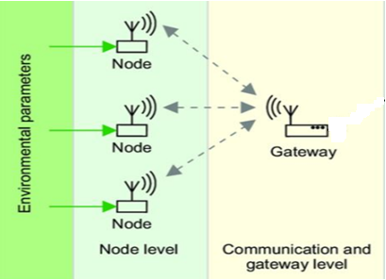
FUNCTIONAL BLOCK DIAGRAM

Slide 8
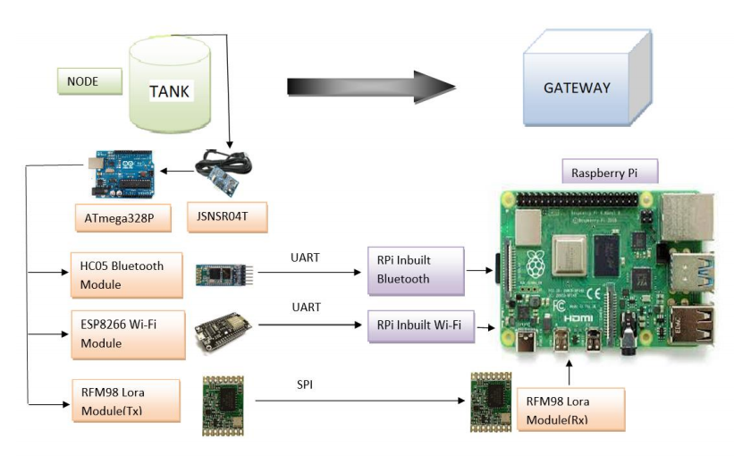
PROPOSED ARCHITECTURE

Slide 9
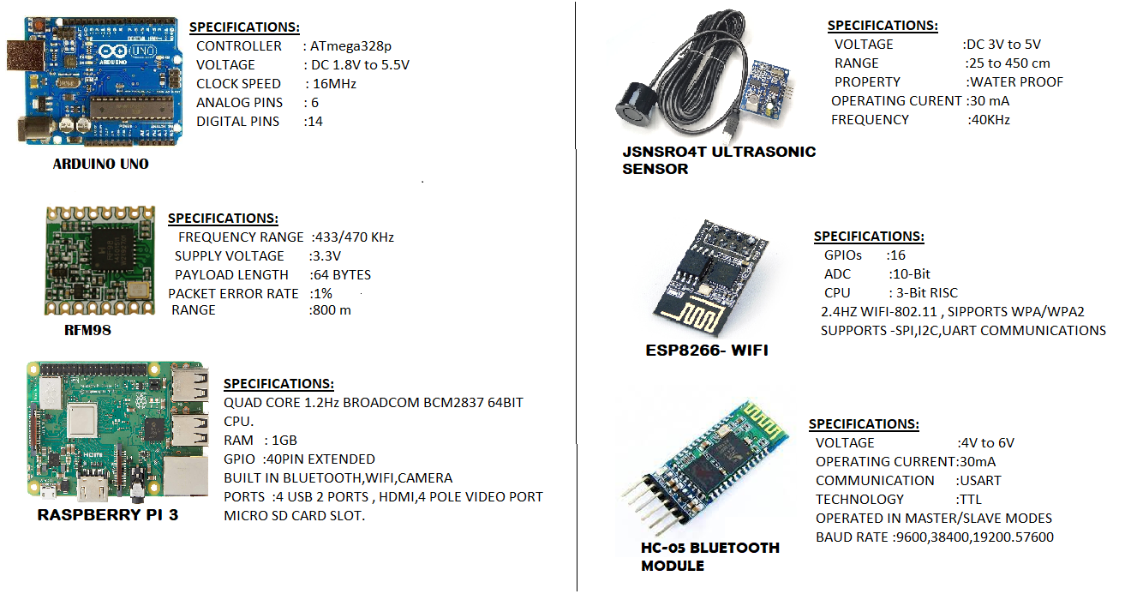
SPECIFICATIONS

Slide 10
ALGORITHM
Step1:Start.
Step2:Initializing the watchdog timer, JSN SR-04T,Sleep Mode, RFM98.
Step3:JSN SR04T measures the water level.
Step4:Returns the Distance .
Step5:Read the Battery level.
Step6:Transmit the data via RFM98/Bluetooth/ESP8266.
Step7:Receive the Concatenated data at raspberry pi.
Step8: Raspberry Pi stores the data in CSV format.
Step9: Stop

Slide 11
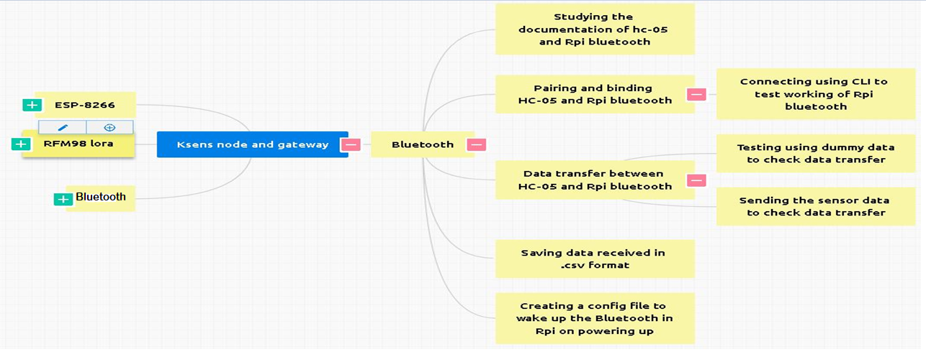
WORK BREAKDOWN STRUCTURE 1

Slide 12
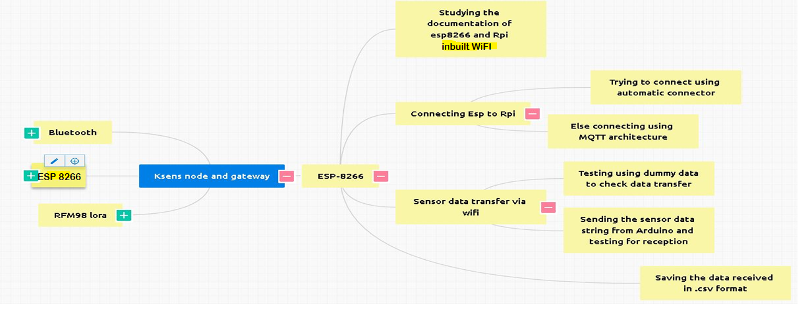
WBS 2

Slide 13
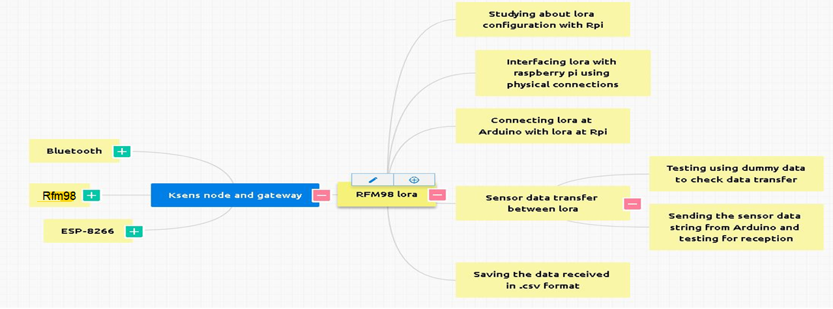
WBS 3

Slide 14
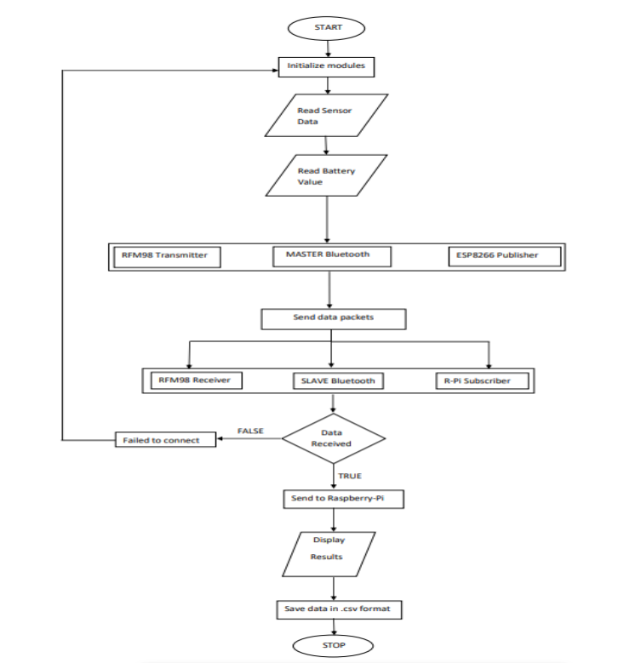
FLOW CHART

Slide 15
IMPLEMENTATION DETAILS
Ksens Node and Gateway is implemented in two phases:
Processing the raw data from sensor node (tank) and transmitting the processed data.
Recieving the processed data at the Gateway and making the data available for visualization.
The proposed system constitutes the following modules at the Transmitter end: ATMega328p as microcontroller JSNSr04T water level detection sensor ,initially RFM98 and eventually BLE, ESP8266 as networking modules.
The proposed system constitutes the following modules at the Receiver end: initially RFM98 and eventually onboard Bluetooth,Wifi of raspberry pi as networking modules.

Slide 16
INPUTS AND OUTPUTS
INPUTS(NODE)
JSNSR04T ULTRASONIC SENSOR GIVES WATER LEVEL OF THE OVERHEAD TANK TO ARDUINO.
THIS DATA IS TRANSMITTED WIRELESSLY .
OUTPUTS(GATEWAY)
SENSOR VALUE i.e WATER LEVEL , NODE AND PACKET NUMBER IS RECEIVED AS OUTPUT TO RASPBERRY PI .
THIS DATA IS STORED IN .csv FORMAT.
12/05/2021

Slide 17
BLUETOOTH COMMUNICATION
Blueman–It is a full featured Bluetooth manager. It provides GUI based setting panel Bluetooth manager.
Bluez–This package provides the Bluetooth protocol stack and the bluetoothctl utility.
Bluetooth–This package provides all the plugins supported by BluezBluetooth stack.

Slide 18
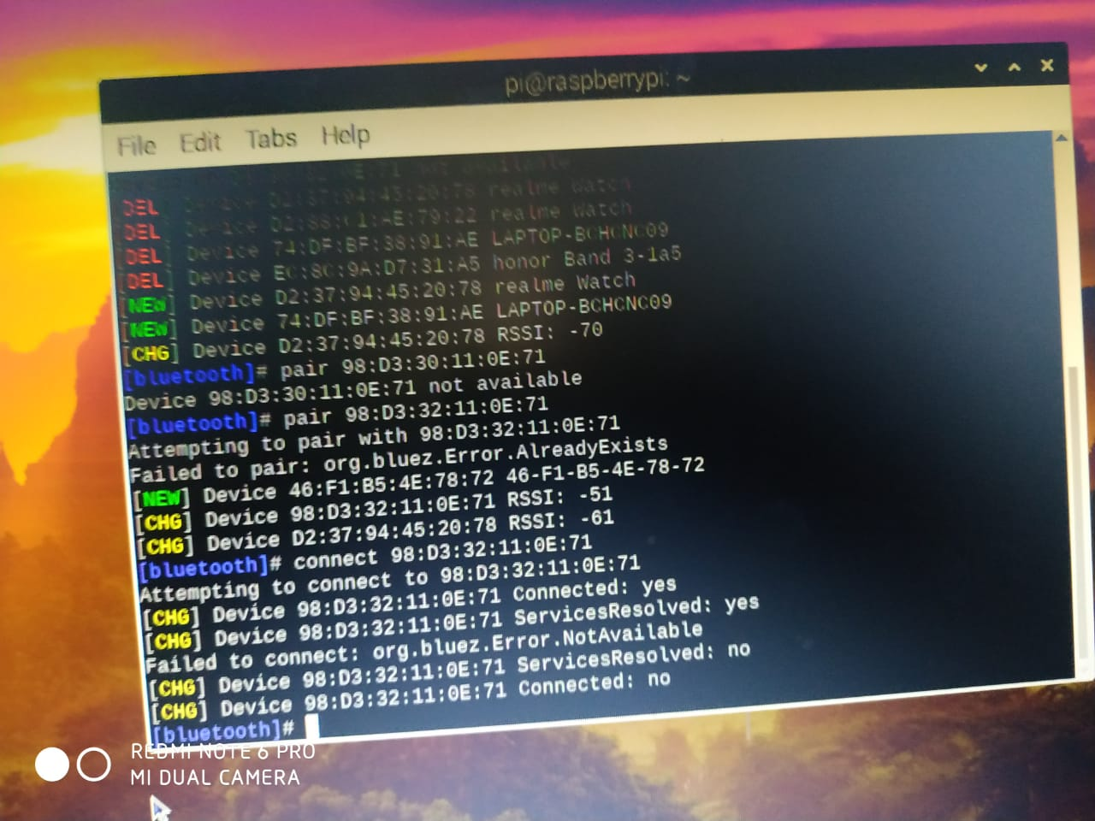
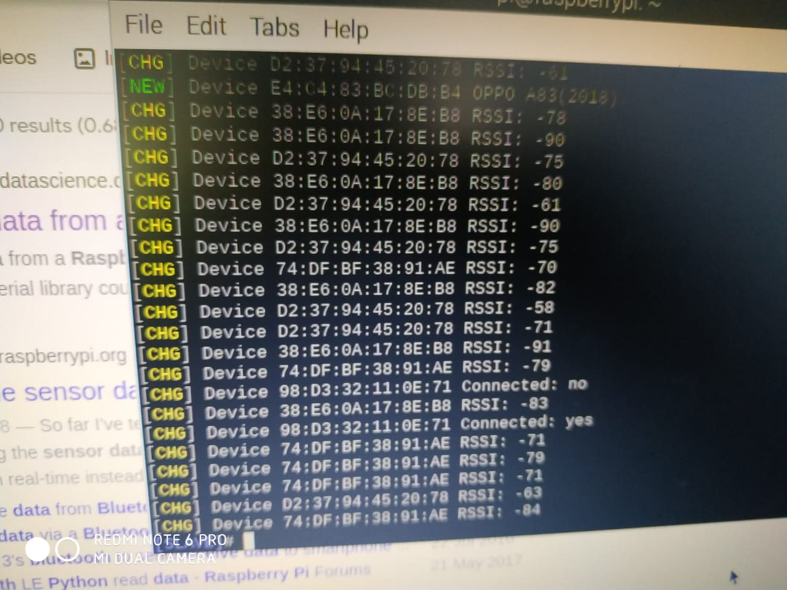
TERMINALS

Slide 19
WiFi Communication Protocol
Adhering to Work breakdown structure 2 , WiFi communication is achieved by a popular WiFi module ESP8266.
Following are the features of ESP8266:
TCP/IP Stack Capability
It has memory, Networking capabilities, SDK
Models:
1.Amica.
2.Clone Lolin

Slide 20
Features Continued ..
Microcontroller: ESP8266-32bit
Clock Speed: 80 MHz
USB Connection: Micro USB port
Operating Voltage: 3.3V
Built in WiFi standard : 802.11
Input Voltage Withstandable.

Slide 21
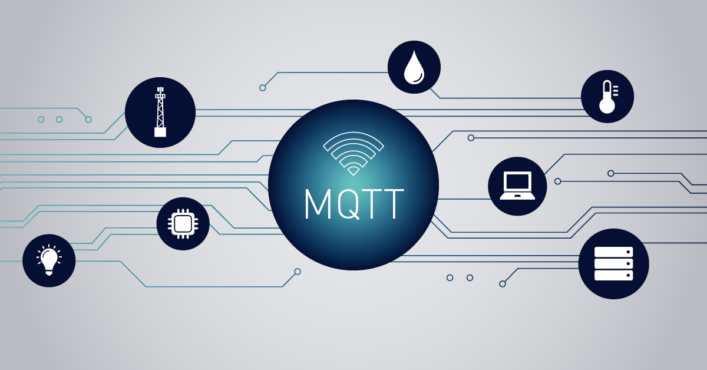
Protocol used : MQTT
Protocol is a standard set of rules that allows the electronics devices to communicate with each other. In simple terms, Protocols are the set of rules running of the sender machine and the receiver machine so that the sent data is correctly understood by the receiver.
Protocols are divided based on the different layers of TCP/IP suite →Application layer
→Transport layer
→Link layer
→ Network layer
MQTT comes under Application layer of TCP/IP suite.

Slide 22
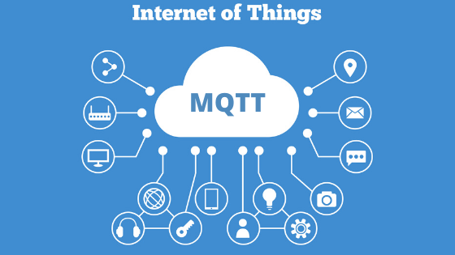
About MQTT
MQTT stands for Message Telemetry Transport protocol.
It is a Light-weight protocol.
MQTT uses Publish Subscribe model.
Architecture: Client-Server(hypothetically).
Client: IoT devices – Publishers and Subscribers.
Servers : Broker.
Clients connect to server and publishes
messages to topic on the server.
The broker forwards the messages to the clients
Subscribed to topic.

Slide 23
More about MQTT
MQTT protocol is specially designed for sensor networks and wireless sensor networks.
It is well suited for constrained environments where the devices have limited processing and memory resources and network bandwidth is low.
Many IoT devices connect over unreliable cellular networks. MQTT’s support for persistent sessions reduces the time to reconnect the client with the broker.
MQTT makes it easy to encrypt messages using TLS and authenticate clients using modern authentication protocols, such as OAuth.

Slide 24

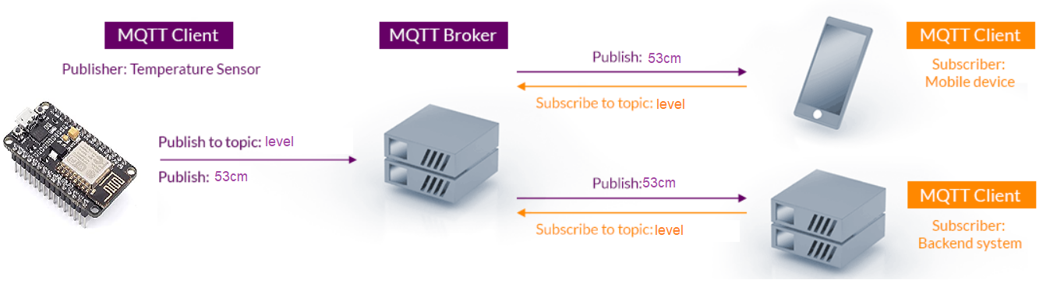
Publish Subscribe Model

Slide 25
LORA COMMUNICATION
Adhering to Work breakdown structure 3, Lora communication is achieved by a popular Lora module RFM98.
Following are the few features of RFM98:
Popular device for long range communication that provides ultra-long range with minimized current consumption.
Frequency : 433/470 KHz.
Range: 800 m.
Has Built-in temperature and low battery indicator.
Supply voltage: 3.3 V
Payload length : 64 bytes

Slide 26
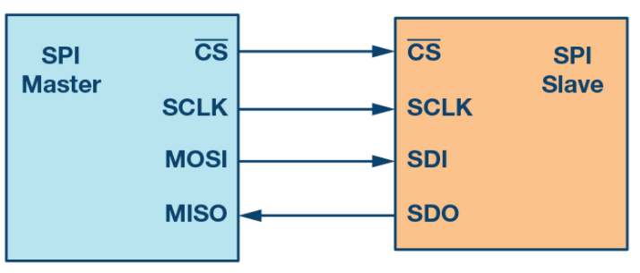
COMMUNICATION PROTOCOL: SPI
Serial peripheral interface (SPI) is one of the most widely used interfaces between microcontroller and peripheral ICs such as sensors, ADCs, DACs, shift registers, SRAM, and others.
SPI is a synchronous, full duplex master-slave-based interface.

Slide 27
MORE ABOUT SPI
MOSI and MISO are the data lines. MOSI transmits data from the master to the slave and MISO transmits data from the slave to the master.
One unique benefit of SPI is the fact that data can be transferred without interruption. Any number of bits can be sent or received in a continuous stream.
Any communication protocol where devices share a clock signal is known as synchronous. SPI is a synchronous communication protocol.

Slide 28
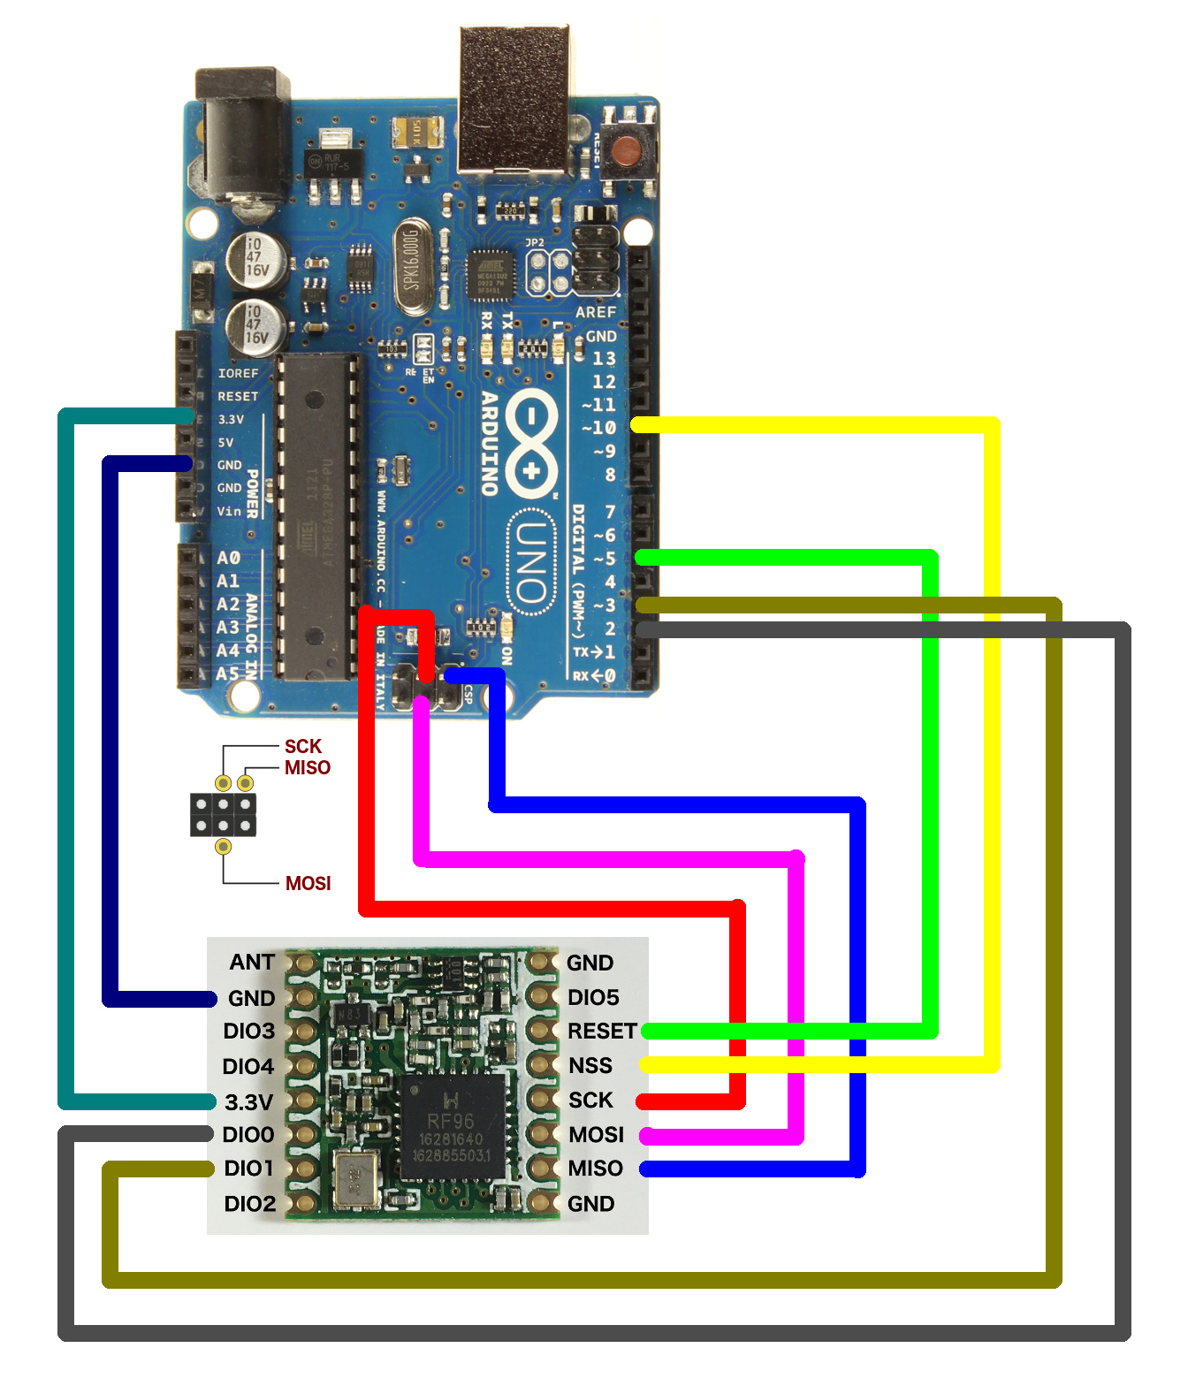
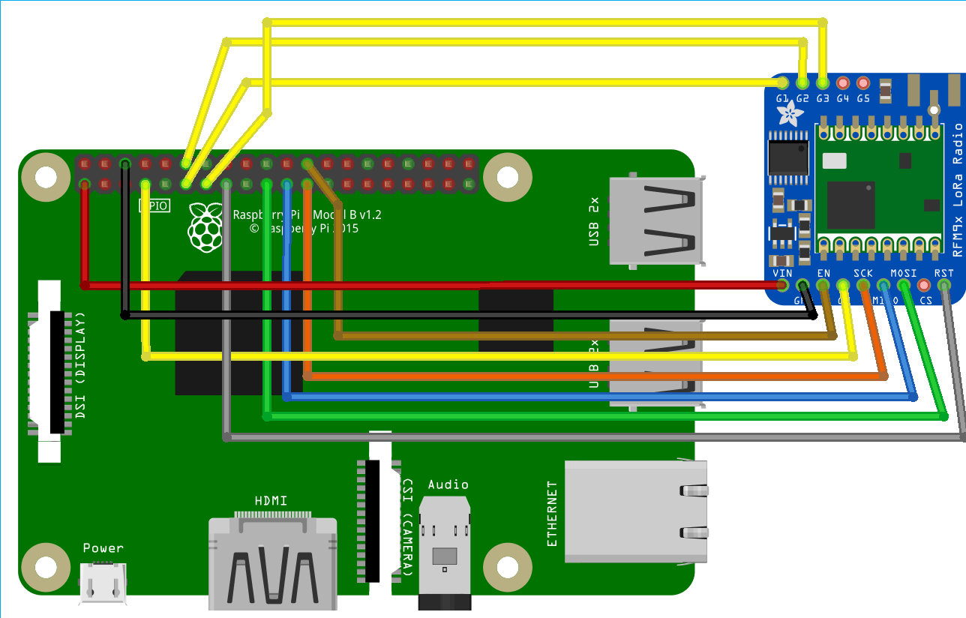

Slide 29
OPTIMIZATION
Our optimization technique is to remove the At mega controller on the gateway side because we have a Raspberry Pi with built-in Bluetooth and Wi-Fi modules.
It is also the best choice for hardware optimization, the customer can choose any means of communication(may be long range or short range ).

Slide 30
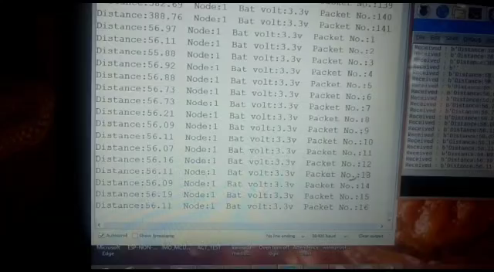
RESULTS FROM BLUETOOTH COMMUNICATION

Slide 31
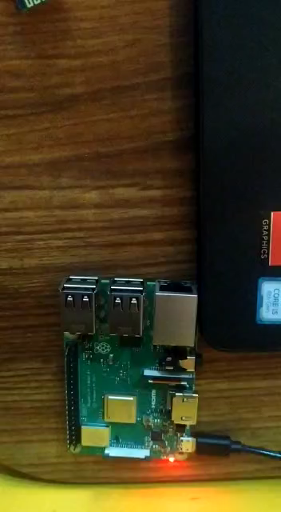
Results from WiFi Communication - Results

Slide 32
THANK YOU

